Slide 1
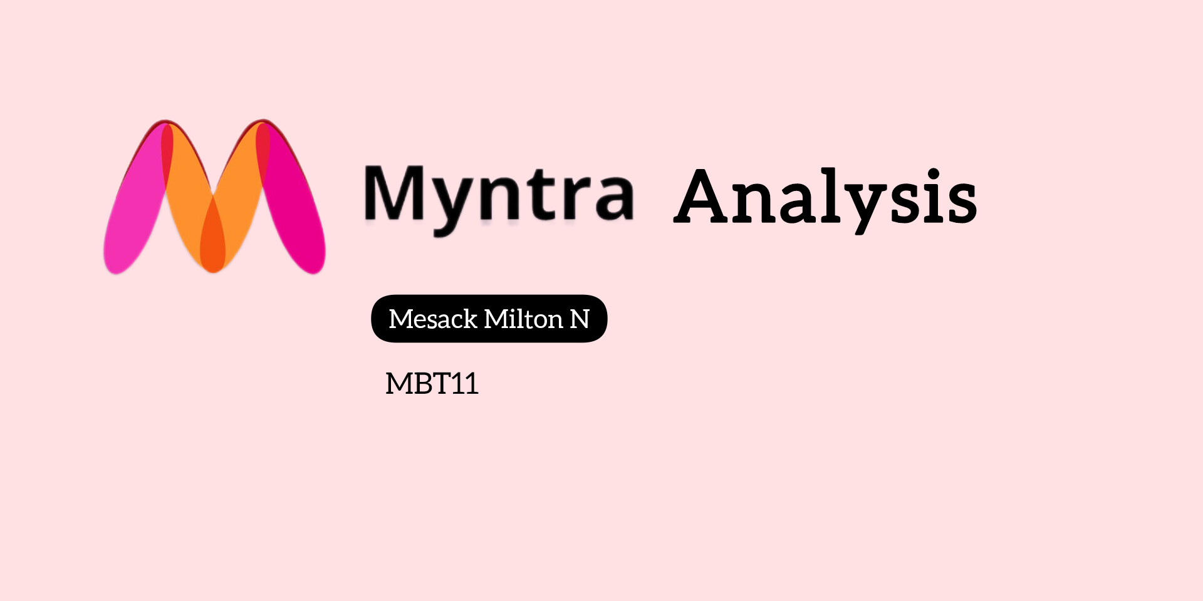

Slide 2
Data collection
Platforms:
Social media platforms (YouTube, Instagram, Facebook, twitter)
Review sites (Trustpilot)
Keywords/Hashtags Used:
#Myntra, #OnlineShopping, #Fashion, #MyntraReview, #CustomerService, #ProductReturnIssues
Findings:
On these platforms, the general customer feedback trends are negative.
Trustpilot reviews show consistent 1-star ratings, with major complaints about:
Poor product quality.
Difficulty in returning products.
Unresponsive customer service.

Slide 3
2. Brand Perception Analysis: Sentiment: Predominantly negative
Key Issues:
Product Quality: Many customers report receiving damaged or incorrect items.
Customer Service: Frequent complaints about unhelpful support and slow responses.
Returns Process: Customers struggle with complicated return procedures and delays in refunds.
Trust Issues: Some users describe Myntra as a "fraud" due to negative experiences.
Conclusion: Most customers have a negative perception of Myntra, mainly due to product quality, poor customer service, and return difficulties. Improving these areas is essential for restoring trust and enhancing the brand's reputation.

Slide 4
3. Customer Sentiment Analysis: - Instagram
Positive Reviews:
percentage: 1%
Examples:
"🥰🥰❤ ❤ "
"Love the looks 😍😍“
Neutral Reviews:
percentage: 4%
Examples:
"How I can place the order"
"Okay"
Negative Reviews:
percentage: 95%
Examples:
"Worst brand ever Myntra, I ordered a product and I got the wrong product...”
"Worst app I received used product"

Slide 5
YouTube
Positive Reviews:
Percentage: 13.64%
Examples:
"CID hats off Myntra respect for you dude"
"Love you, Ranbir"
Neutral Reviews:
Percentage: 31.82%
Examples:
"What is the duration for the sale?"
"Thanks universe"
Negative Reviews:
Percentage: 54.55%
Examples:
"One of the worst app in sale season order getting cancelled and customer care not responding"
"Don’t purchase from Myntra... fake people fake promise scammer money digger, no customer support"

Slide 6
Twitter
Positive Reviews:
Percentage: 6.82%
Examples:
"Superrrr excited for #MyntraBigFashionFestival"
"Triple the charm, triple the savings!"
Neutral Reviews:
Percentage: 13.64%
Examples:
"What is the duration for the sale?"
"Ordered on 26th Sep, delivery delayed multiple times from 1st to 5th Oct."
Negative Reviews:
Percentage: 79.55%
Examples:
"Worst company ever! Sent wrong product, don’t accept the return policy."
"One of the worst apps in sale season order getting canceled and customer care not responding."

Slide 7
Facebook
Positive Reviews:
Percentage: 9%
Examples:
"My fav trio is NEIL NITIN MUKESH"
"Nice ad Ranbir Kapoor shopping Big festival"
Neutral Reviews:
Percentage: 10%
Examples:
"Kindly send OTPs correctly. For want of it, the poor delivery boy and I were at our wit's end.""
"Adds be like wow so much discount on Myntra"
Negative Reviews:
Percentage: 81%
Examples:
"Worst Don't buy anything from @myntra @amazonIN is the best."
"Worst company ever! Sent wrong product, don’t accept the return policy."

Slide 8
Major Themes and Sentiments Associated with Myntra:
Product Quality:
Sentiment: Mostly negative
Theme: Many customers express dissatisfaction with receiving damaged or in correct items.
Customer Service:
Sentiment: Predominantly negative
Theme: Frequent complaints about unresponsive or unhelpful customer support.
Returns and Refunds:
Sentiment: Highly negative
Theme: Significant issues reported with the returns process, including delays and lack of follow-up.
Trust and Reputation:
Sentiment: Mostly negative
Theme: Customers express a lack of trust in Myntra, with many labeling it as a fraudulent company.

Slide 9
4. Market Trends Identification:
Sustainable Fashion: Rising demand for eco-friendly products.
Athleisure & Comfort: Growing preference for casual, comfort-driven attire.
Seasonal Fashion: Popular during sales and festivals, especially ethnic wear.
Bold Colors & Patterns: Trendy among influencers and customers.
Discounts & Sales: Strong customer interest in big sales like #MyntraBigFashionFestival.
Influencer Impact: Celebrity endorsements shaping trends.
Sustainable Fashion:
Reason: More people are becoming aware of environmental issues. They want clothes that are made in a way that is better for the planet, so eco-friendly products are becoming popular.
Athleisure & Comfort:
Reason: During the pandemic, many people stayed at home and focused on comfort. This made them prefer clothes that are easy to wear, like activewear and casual outfits, which they can use for both exercising and lounging.

Slide 10
Seasonal Fashion:
Reason: In India, festivals are important and often involve special clothing. People like to buy new traditional clothes during these times, leading to a rise in seasonal fashion sales.
Bold Colors & Patterns:
Reason: Influencers on social media often show off bright and unique styles. Many young people follow these trends to stand out and show their personal style, making bold colors and patterns popular.
Discounts & Sales:
Reason: Big sales events attract shoppers who want to save money. Many people look forward to these sales, like festive seasons or special online events, to get great deals on clothes.
Influencer Impact:
Reason: Social media influencers have a lot of followers who trust their opinions. When influencers promote certain styles or products, their followers are likely to want to buy those items too,

Slide 11
5. Myntra vs. Key Competitors – customer satisfaction
Myntra:
Sentiment: Predominantly negative
Key Issues: Product quality, poor customer service, difficult returns, and refund process.
Feedback: Customers often express distrust and mention feeling "scammed.“
Amazon Fashion:
Sentiment: Largely positive
Strengths: Strong customer service, reliable delivery, and hassle-free returns.
Feedback: High praise for variety and prompt support.
Flipkart:
Sentiment: Mixed (leaning positive)
Strengths: Competitive pricing and broad product selection.
Feedback: Generally positive, but some frustration with customer service and returns.
AJIO:
Sentiment: Mixed
Strengths: Trendy collections and unique fashion options.
Feedback: Occasional delivery and sizing complaints, but appreciated for stylish offerings.

Slide 12
5.a Product Range:
Myntra:
Focuses heavily on fashion and lifestyle products, offering a wide variety of clothing , accessories, and footwear.
Collaborates with several well-known brands and offers frequent sales and discounts, which attract price-sensitive customers.
Amazon Fashion:
Has an expansive range of products beyond fashion, including electronics, groceries ,and household items.
Fashion is just one segment within Amazon’s vast marketplace, but it still provides a good selection of global and domestic brands.
Flipkart:
Like Amazon, Flipkart is a multi-category platform with a significant focus on electronics, but it also has an extensive fashion range.
Flipkart’s fashion section is competitive, offering both affordable and premium brands.
AJIO:
Specializes in fashion, with a focus on curated collections of clothing and accessories, often positioning itself as a more trendy and modern alternative to competitors.
Offers exclusive and in-house brands, as well as high-end designer wear, appealing to fashion-forward customers

Slide 13
5.b Market Presence:
Myntra:
Strong presence in India’s online fashion segment. It is well-known for its regular sales and discounts, especially during festive seasons.
However, its market reputation is currently at risk due to negative customer experiences with product quality and returns.
Amazon Fashion:
Amazon’s vast customer base and established market presence make it a top competitor. Its presence spans not just India but globally, benefiting from high brand trust and extensive logistics.
Although fashion is not Amazon’s primary focus, it has gained considerable market share due to its seamless shopping experience and reliability.
Flipkart:
One of the dominant players in Indian e-commerce, Flipkart is Amazon’s main competitor in India.
Flipkart has solidified its market presence, particularly through its affordable pricing, extensive product range, and strong customer loyalty in the fashion and electronics categories.
AJIO:
AJIO is a relatively new player compared to Myntra, Amazon, and Flipkart, but it has quickly gained a niche following due to its focus on fashion-forward and exclusive items.
Its market presence is growing, especially among younger, trend-conscious shoppers looking for unique fashion options.

Slide 14
6. Strategic Recommendations:
6.a Enhance Customer Service:
Training Programs: Conduct regular training sessions for customer service representatives to improve their communication, problem-solving skills, and product knowledge.
Feedback Mechanism: Implement a strong feedback system with surveys and follow-up calls to gather customer insights.
24/7 Support: Provide round-the-clock customer service, especially during peak seasons.
6.b Revamp Returns and Refund Processes:
Simplified Return Policy: Make the return policy more customer-friendly and streamline the process to improve satisfaction.
Return Pickup Services: Collaborate with local logistics providers to offer convenient return pickups.
Clear Communication: Ensure return and refund policies are clearly explained on the website
6.c Improve Product Quality:
Quality Control: Enhance vendor checks and conduct regular audits to minimize defects.
Customer Reviews: Encourage feedback to guide buyers and identify improvement areas.
Brand Collaboration: Partner with brands to meet customer quality expectations.

Slide 15
6.d Leverage Data Analytics:
Customer Segmentation: Analyze behavior to create personalized marketing offers.
Trend Analysis: Monitor social media to align products with market trends.
Sales Forecasting: Use predictive analytics for effective inventory management.
6.e Strengthen Brand Image:
Marketing Campaigns: Highlight testimonials to rebuild trust.
Partnerships: Collaborate with influencers for brand awareness.
Corporate Social Responsibility: Engage in sustainability initiatives to improve brand image

Slide 16
THANK YOU

